Slide 1
What I've Learnt Living In Luxembourg
Reflecting on the last 5 months

Slide 2
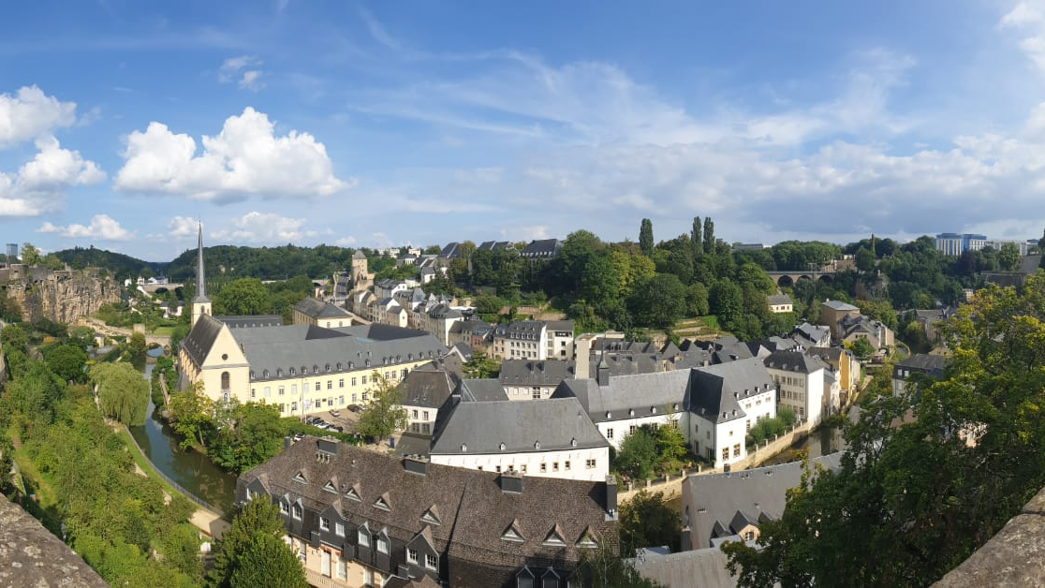
Old Town, View from the City Centre

Slide 3
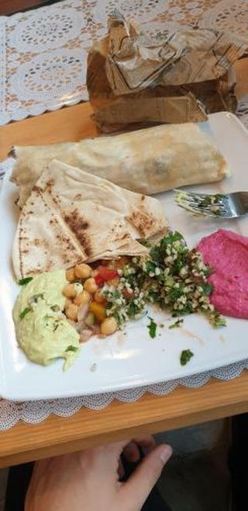
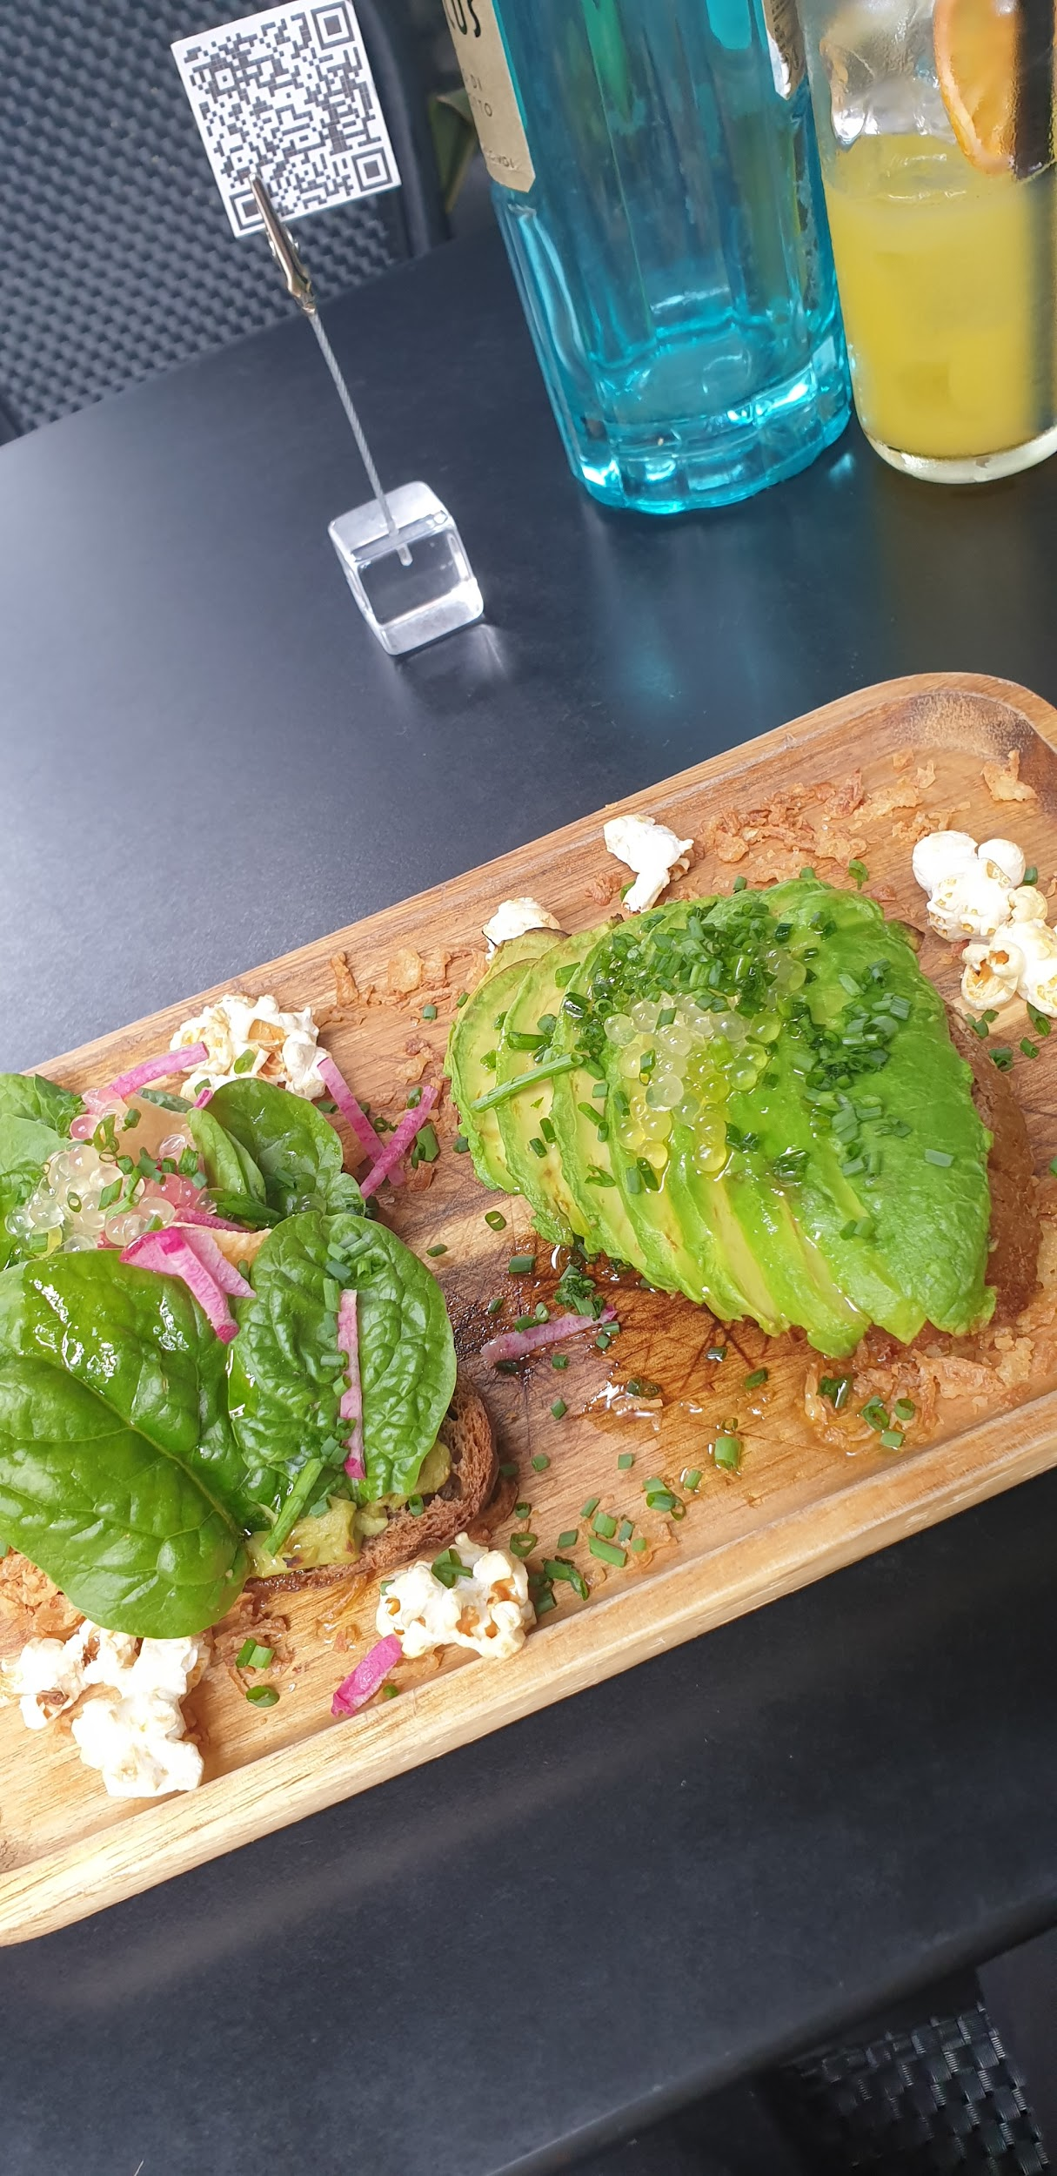
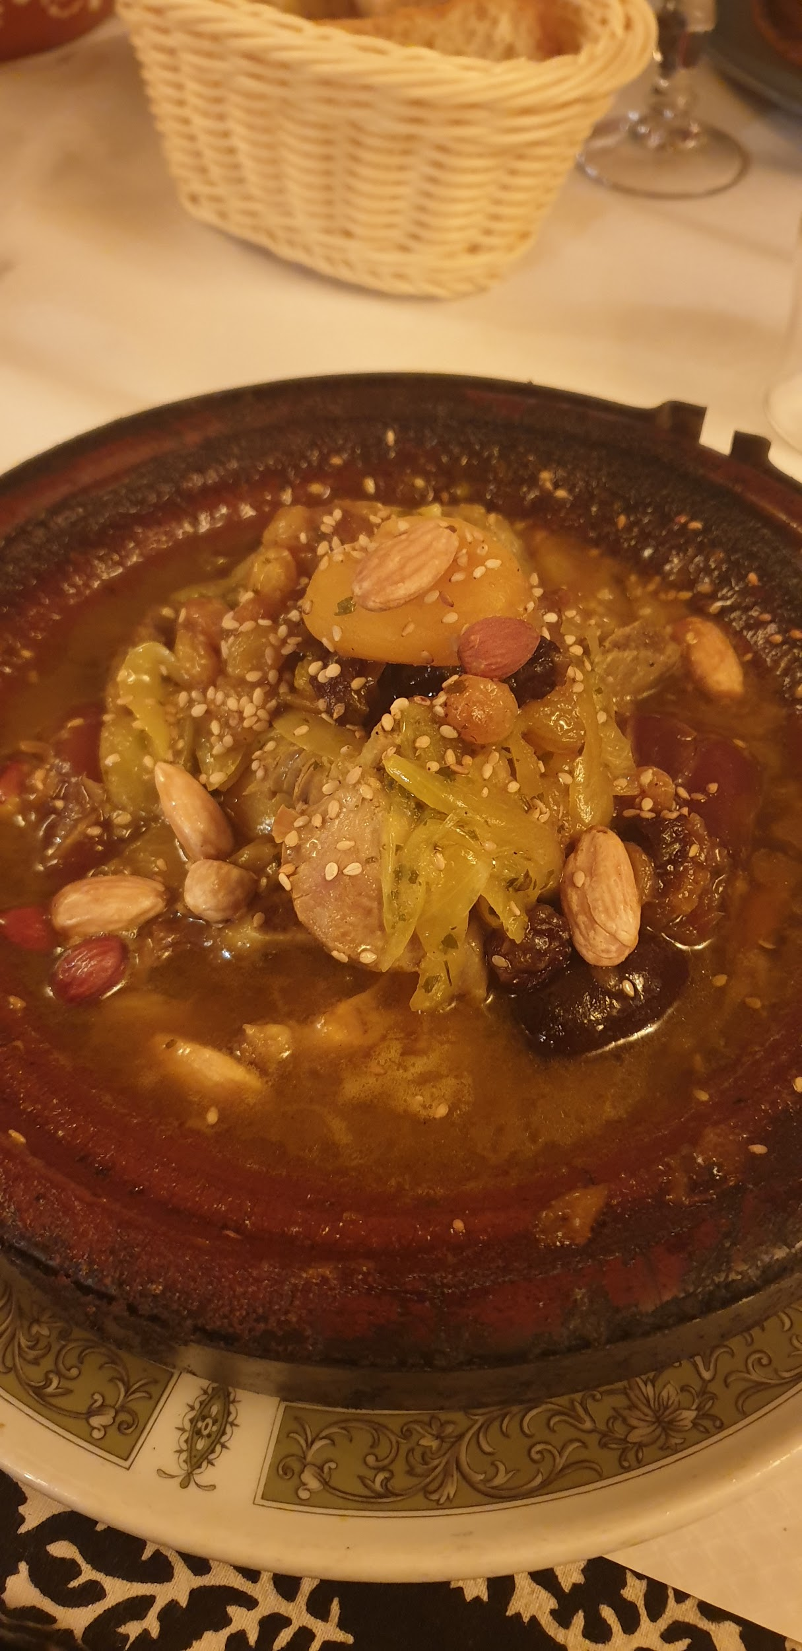
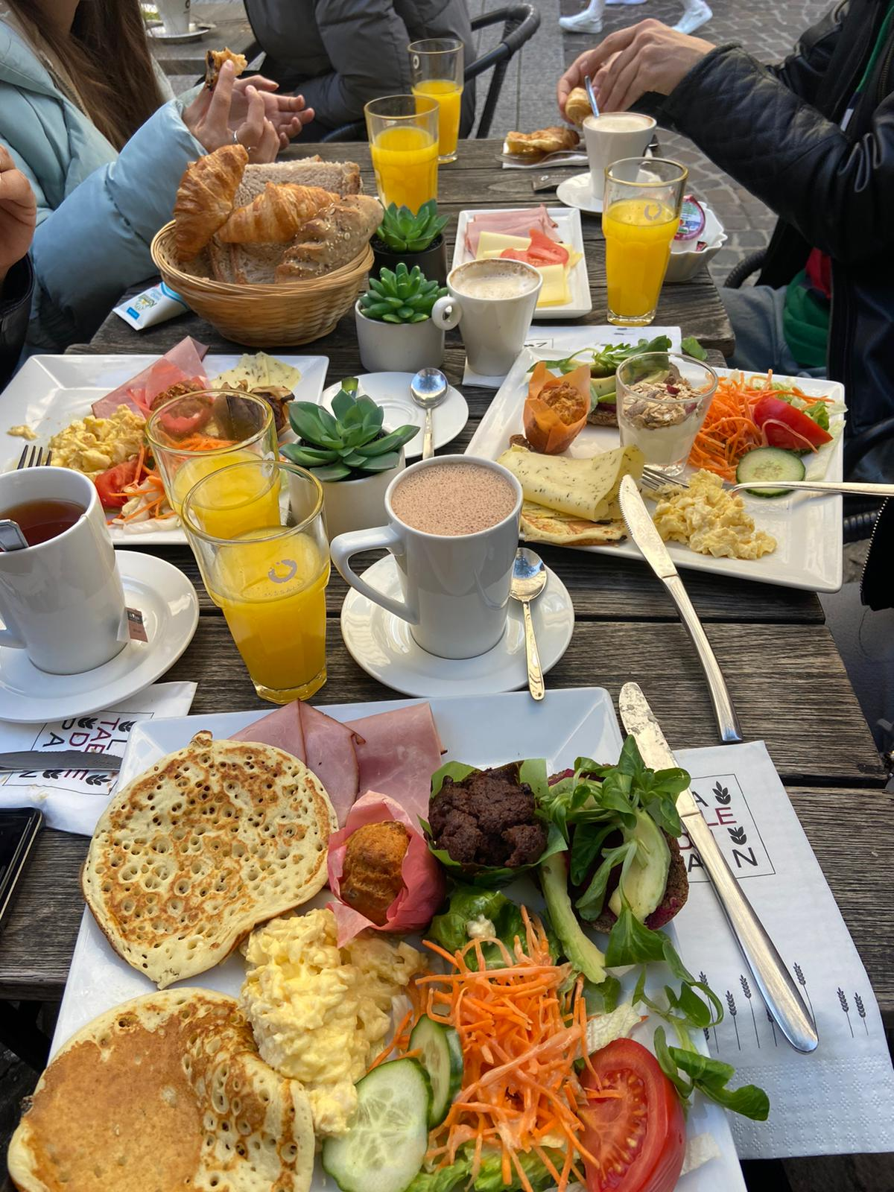
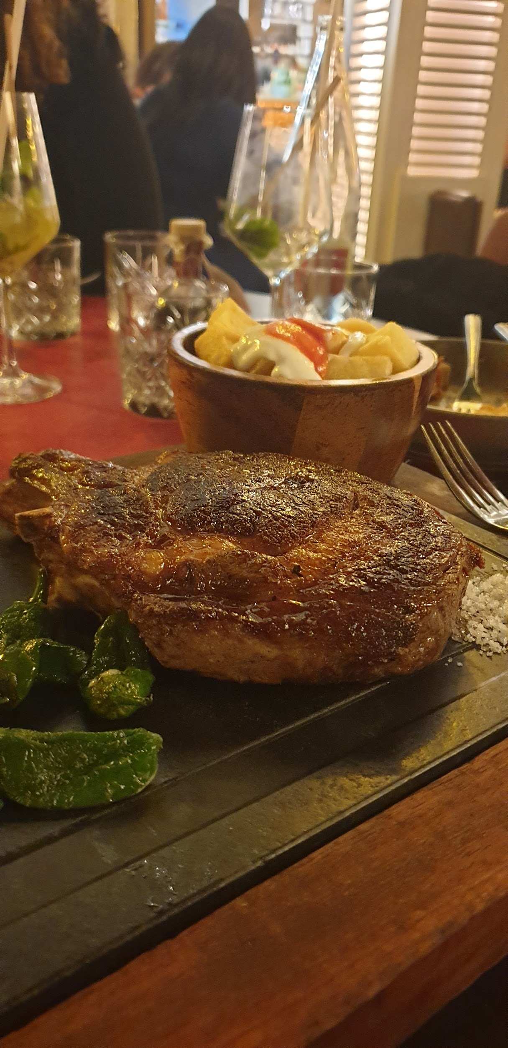
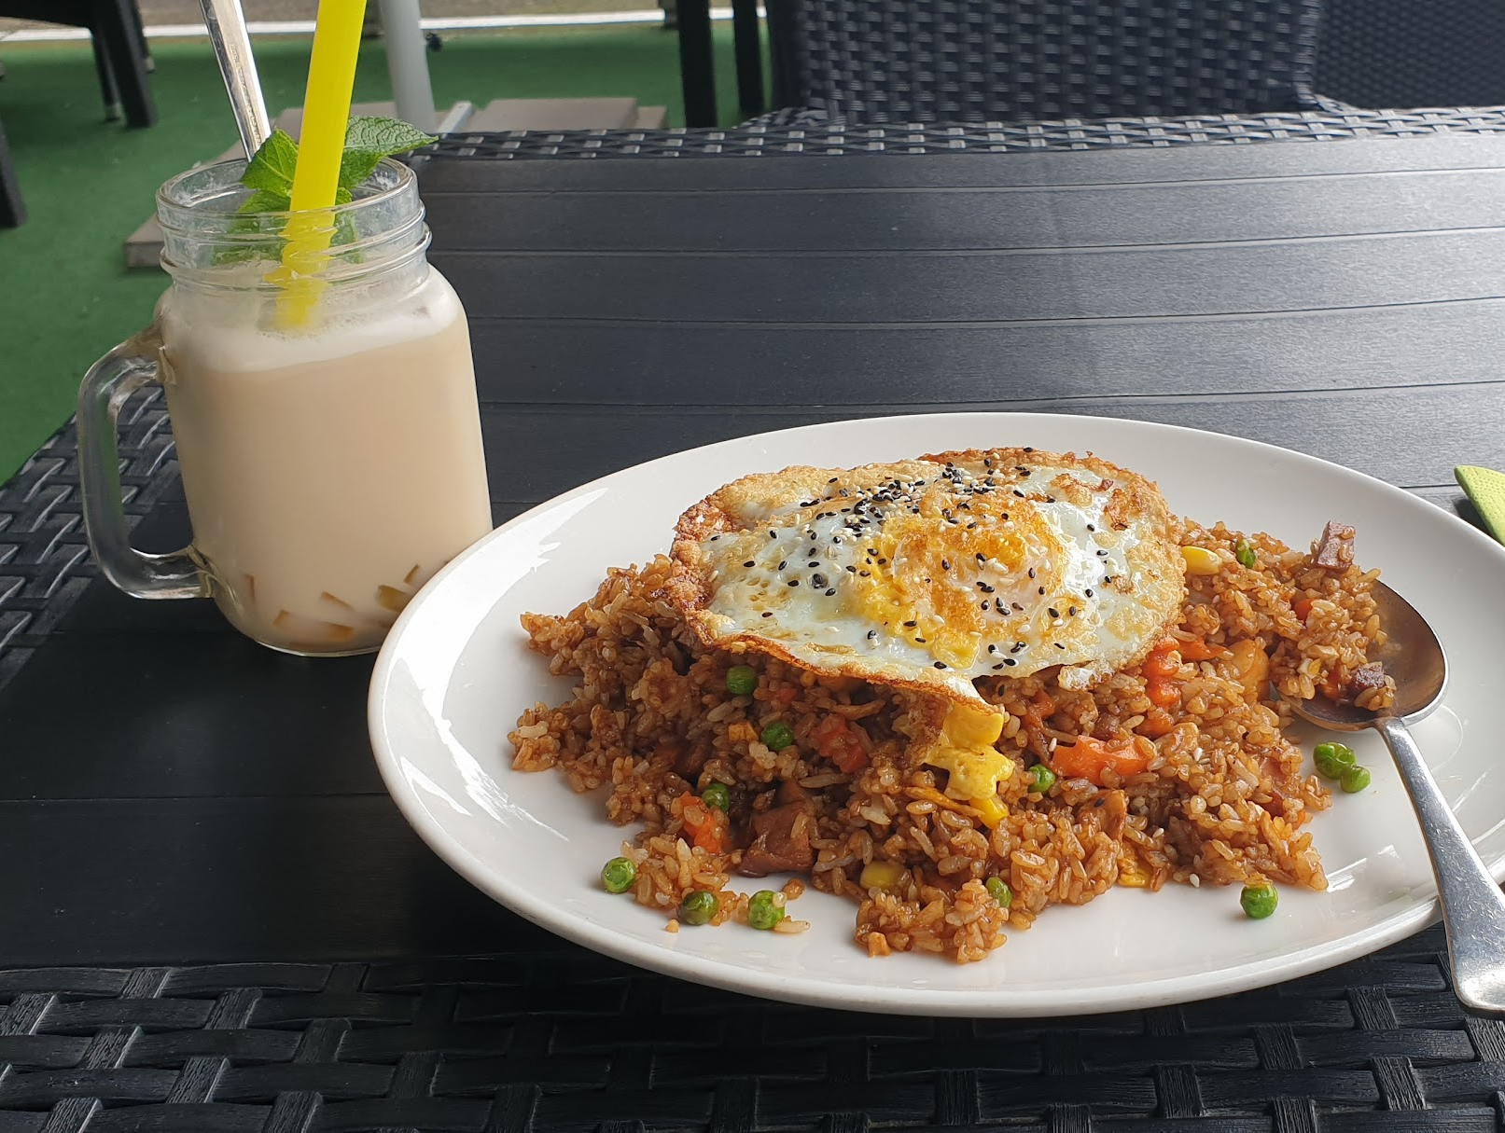
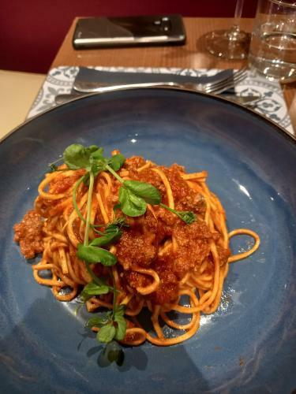
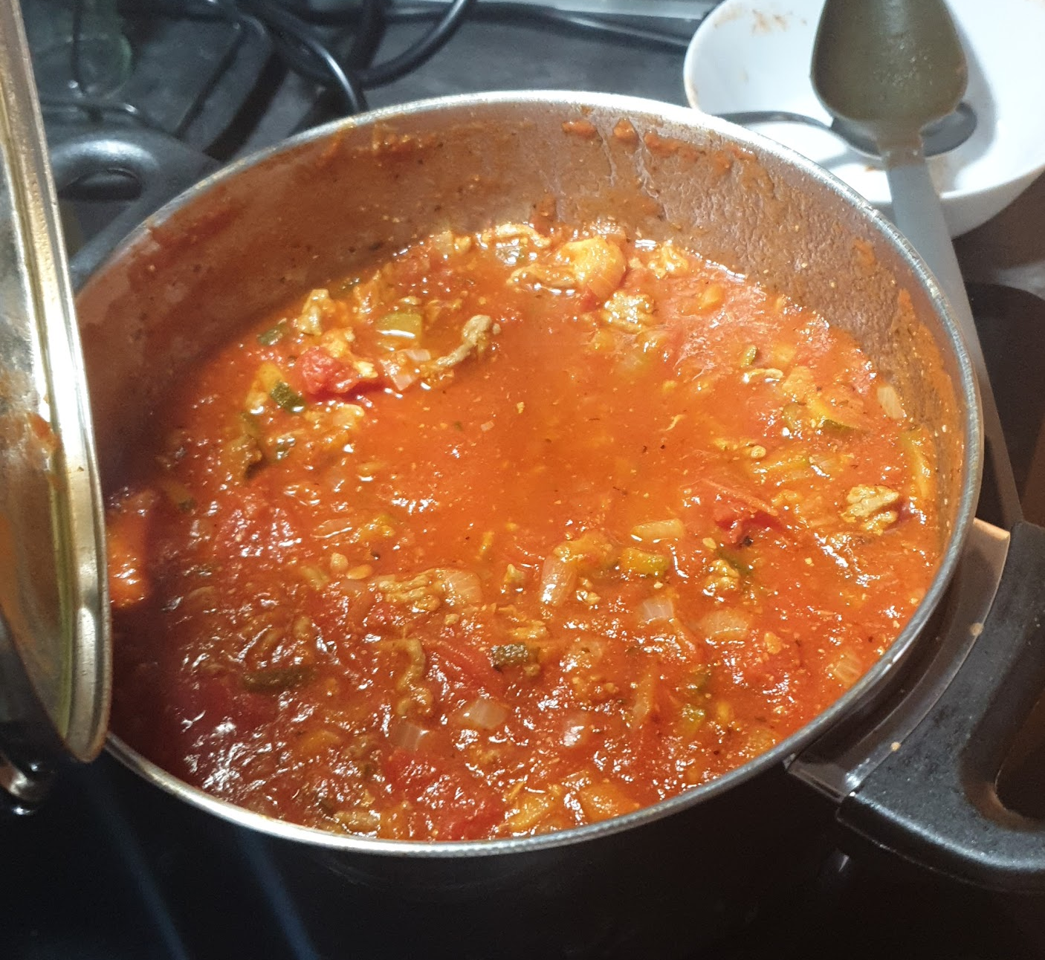
Food

Slide 4
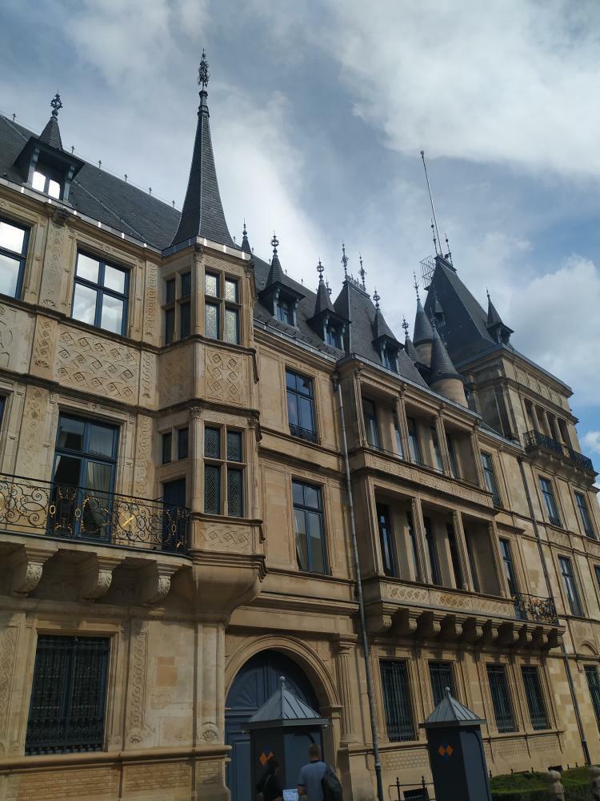
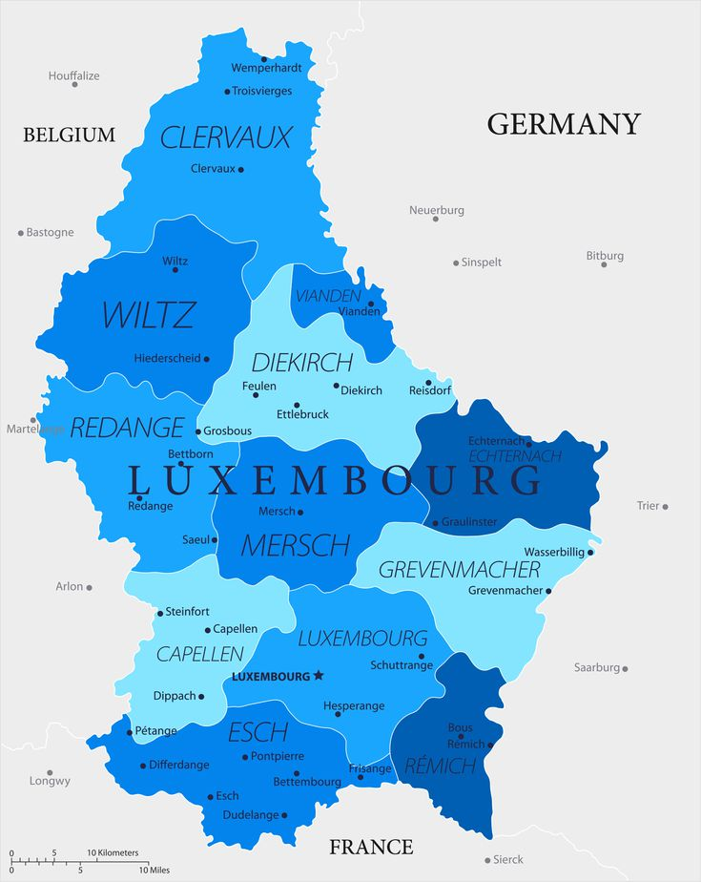
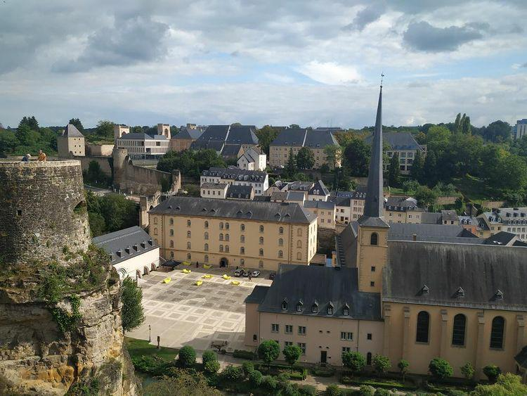
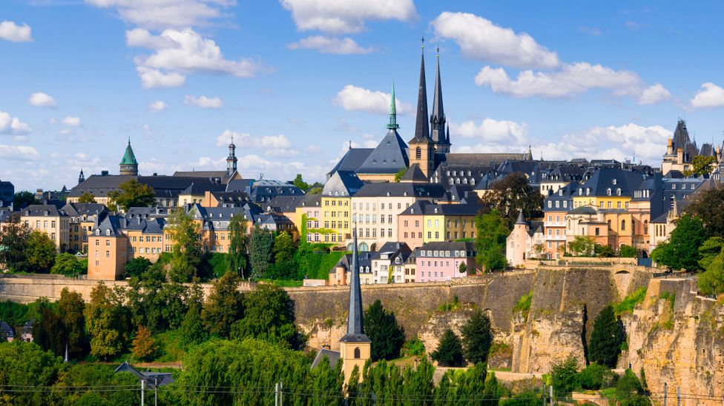
The Culture
Old Town - Wow
The City - Normal
The Rest - Countryside
French Hybrid Culture
Business Focused
Cautious
Private
Working Life

Slide 5
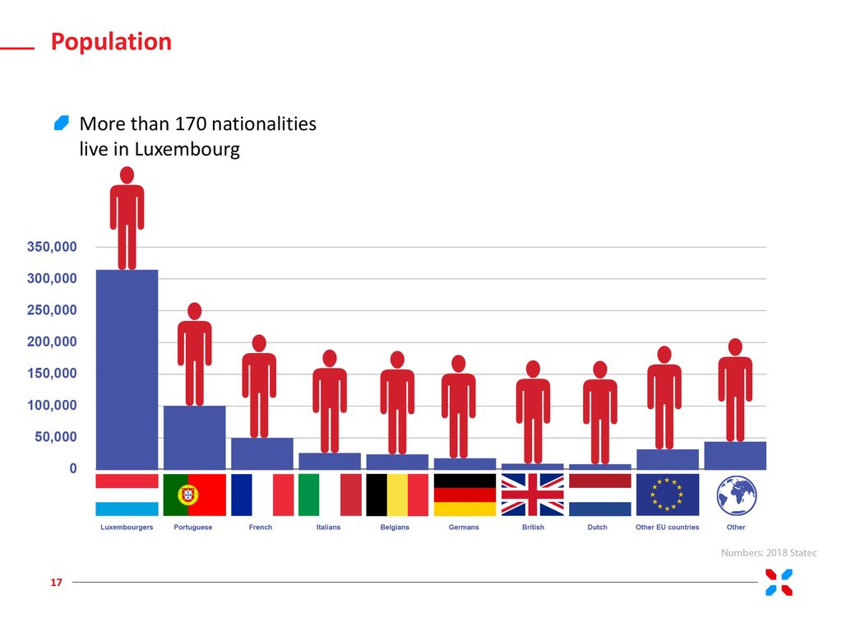
The People
Small but diverse population
French are French
Portuguese are cool
Fake Internationalism
Actual Luxembourgish are:
Rare
Weird
Oddly Patriotic/Entitled
Either Welcoming or Xenophobic

Slide 6
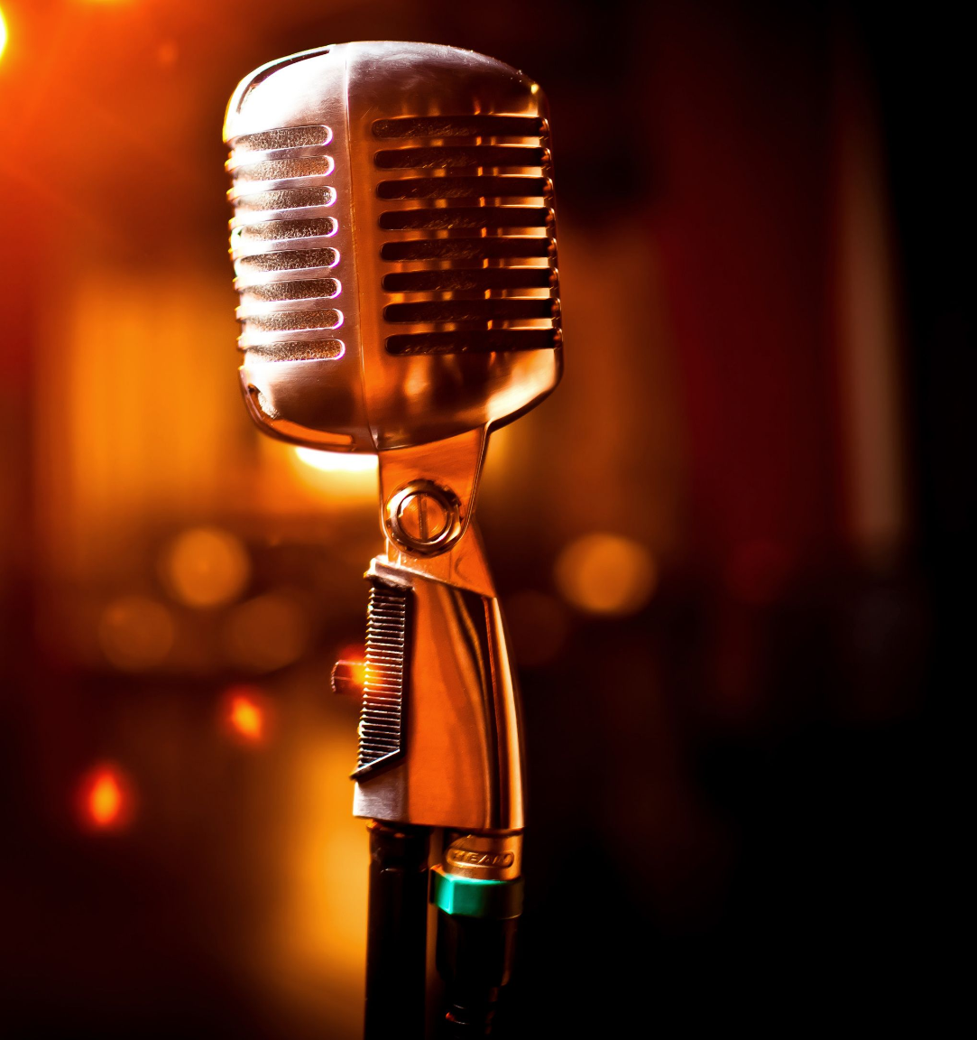
Open Mic
Q&A

